Slide 1
Fossils
Science Olympiad

Slide 2
Review
What is the difference between external molds and casts?
What is the difference between internal molds and casts?
What is the difference between external molds and internal molds?

Slide 3
Altered remains

Slide 4
Replacement
Original mineral has been dissolved away and replaced by a different mineral.
Usually the original mineral was aragonite or calcite, and it has been replaced by silica (in oxidizing and acidic conditions) or pyrite (in reducing conditions, in the absence of oxygen).
Recognizing replacement requires that you first be able to recognize what mineral you are looking at, and then that you know what the original skeletal material was.

Slide 5
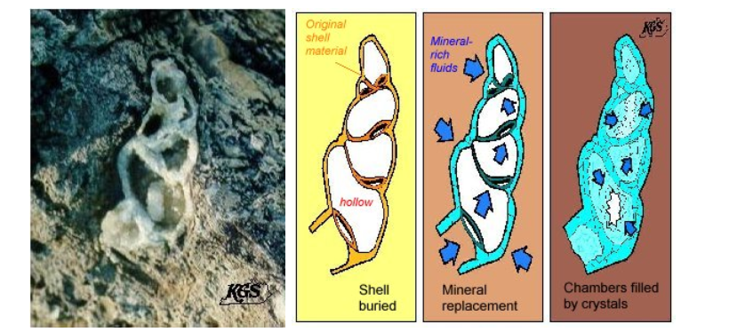
Recrystallization
Original mineral has recrystallized, either to different crystal system (aragonite to calcite) or by crystals growing. The original fine structure of the fossil is lost.

Slide 6
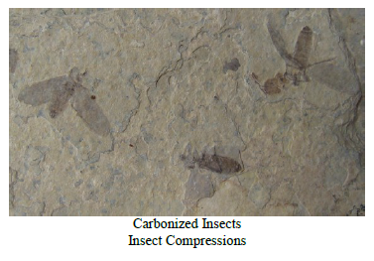
Carbonization/Coalification
Carbonization is a process by which the more volatile substances of plants and animals decay, but leave behind the carbon.
When organisms become trapped and squeezed between sediments they may form compressions
The soft parts of the organism were compressed and heated, driving off all the volatiles (H, N, O). A carbon film is left behind

Slide 7
Trace Fossils

Slide 8
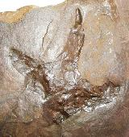
Trace fossils
Trace fossils are other kinds of evidence that an organism existed.
Trace fossils include any impression or other preserved sign of activity (for example, feeding, scratching, burrowing, walking, or resting)
Trace fossils include tracks, trails and footprints; burrows and other dwellings; tools; coprolites (fossilized excrement); and chemical fossils, which is chemical evidence of the existence of an organism.
Dinosaur Footprint

Slide 9
Unaltered Remains

Slide 10
Actual remains
These are much rarer than other fossil types. These are still intact parts of the organism. Actual remains can be seen preserved in ice, tar, or amber. A good example is mammoth hair. It is often frozen and still preserved

Slide 11
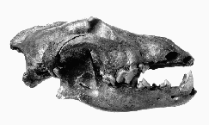
Tar
When organisms become trapped in tar, due to the oxygen deprived environment, it allows for the rapid burial of body parts which are well preserved. A good example is the La Brea tar pits in Los Angeles.
Canis lupus furlong gray wolf skull

Slide 12
Review
Trace Fossils
Impressions
External molds
Internal molds
Casts
Altered Remains
Replacement
Recrystallization
Carbonization/ Coalification
Petrification/Petrafication/Silication
Unaltered Remains
Actual Remains
Tar

Slide 13
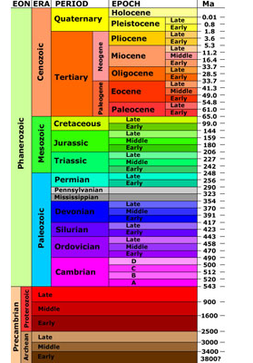
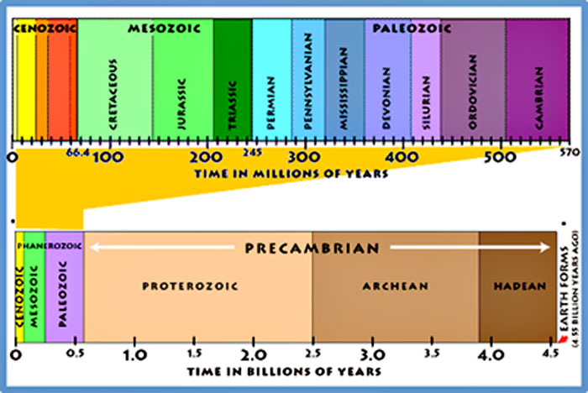
Geological Time Scale

Slide 14
First fossils
There are, however, fossils called stromatolites that show indications of cyanobacteria. These are first found in the Archaean.
It is possible that the first lifeforms and self replicating RNA strands emerged as early as the mid-Hadean.
The Phanerozoic Eon is when shelled invertebrates began to emerge, and the fossil record expands.

Slide 15
Eras
The Paleozoic (meaning "ancient animals", from 540 mya to 243 mya) was dominated by marine invertebrates.
Reptiles dominated the Mesozoic (middle animals) Era (from 243 mya to 65 mya), and mammals dominate the Cenozoic Era (65 mya to present, meaning "recent animals").
We are living in the Cenozoic Era now.

Slide 16
Periods of Paleozoic
Cambrian: (540 mya to 505 mya) The first period, this is when marine invertebrates start to emerge.
Ordovician: (505 mya to 438 mya) Primitive fish start to form. Index fossil is the trilobite genus Cryptolithus.
Silurian:(438mya to 408 mya) Early land animals began to emerge.
Devonian: ( 498 mya yo 360 mya) First forests and amphibians form. Index fossils include Mucrospirifer (brachiopod genus) and Phacops (trilobite genus).
Mississippian: (360 mya to 320 mya) Widespread shallow seas form.
Pennsylvanian: ( 320 mya to 286 mya) Coal bearing rocks form.
Permian: ( 286 mya to 245 mya) Earliest gymnosperms (cone bearing trees).

Slide 17
Periods of Mesozoic
Triassic: ( 245 mya to 208 mya) First dinosaurs and earliest mammals.
Jurassic: ( 208 mya to 144 mya) Earliest birds.
Cretaceous:(144 mya to 65 mya) Flowering plants (angiosperms) develop.

Slide 18
Periods of Cenozoic
Tertiary: Apes begin to appear. It is broken down into epochs:
Paleocene (65 mya to 58 mya)
Eocene: (58 mya to 37 mya) further development of mammals.
Oligocene: (37 mya to 24 mya) Rise of true carnivores
Miocene: (24 mya to 5 mya) Grasses and grazing animals develop.
Pliocene: (5 mya to 2 mya) First modern animals
Quaternary: Humans appear and develop. This is the period we are still in today. Pleistocene: (2 mya to 10,000 ya): First humans.
Holocene: (10,000 ya to present): The epoch in which we live today. The Holocene is further divided into the Boreal Age, followed by the Atlantic Stage.

Slide 19
Practice Test

